Slide 1
Opto-couplers
Known as opto-isolator.
Provides optical isolation and coupling between two circuits.
Creating physically and electrically isolated signal coupling between them.
Assembled with traditional semiconductor packages contains-
LED and
Photosensitive semiconductor device in the same housing
1

Slide 2
Optocouplers
LED for emitter
Air as barrier for isolation
Phototransistor for detector
Transformer is similar, but only for AC
Optocoupler can be used for DC

Slide 3
Opto-couplers
Excellent isolating device because of their light coupling medium.
Allowing very large isolation voltage between circuits.
Commercial optocouplers use infrared light or laser beams as transmitting medium.

Slide 4
When to Use
There are many situations where signals and data need to be transferred from one subsystem to another within a
piece of electronics equipment, or from one piece of equipment to another, without making a direct electrical connection.
Often this is because the source and destination are at very different voltage levels, like a microprocessor which is operating from 5V DC but being used to control a triac which is switching 240V AC.
In such situations the link between the two must be an isolated one, to protect the microprocessor from overvoltage damage.

Slide 5
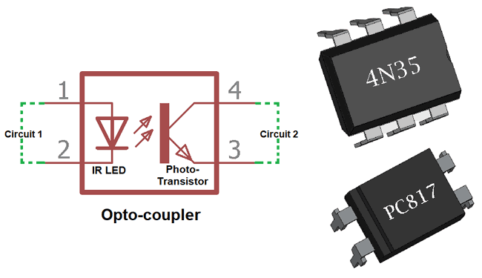
Typical Optocoupler Configurations

Slide 6


Typical Optocoupler Configurations
(a)
(b)

Slide 7
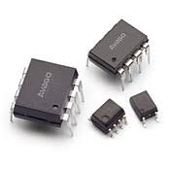
Typical Optocoupler ICs

Slide 8
Typical Optocoupler Configurations (cont.)
Configuration is divided into 2 parts.
Receiving Side
Transmitting Side
Both sides are encapsulated in a single 8-pin dual-in-line packages.

Slide 9
Typical Optocoupler Configurations (cont.)
In transmitting side LED can be made to emit light by passing specified amount of forward current.
In receiving side we can use three types devices
Photo diode
Photo Transistor
Photo Darlington-Pair

Slide 10
Typical Optocoupler Configurations (cont.)
Photo diode is used for-
High speed operation
Produce current by detecting light.
Photo Transistor provides-
moderate speed but higher output current.
Photo Darlington-pair is used for-
High transfer ratio but lower speed.

Slide 11
Block diagram of Optocouplers
Vin
Vout
LED
(Transmitter)
Photosensitive devices (receiver)

Slide 12
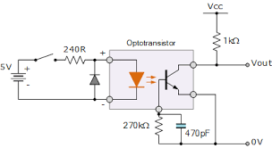
Typical Circuit

Slide 13
Functions of Optocouplers
LED and the photosensitive device are assembled in such a way that the light emitted by the LED would strike the photosensitive device and trigger it into conduction.
Emission travel through a transparent gap until it gets picked by the Photosensitive devices.
Output waveform is identical to the input waveform , although their amplitudes usually differ.

Slide 14
Applications of Optocouplers
Opto-isolation is important where ‘fragile’ digital circuits are at risk of being damaged by large transient voltage or spikes.
Common applications is in modem which allow the computer to connect with telephone line without risk of damage from the line transients.

Slide 15
Other Applications of Optocouplers
Isolated line receiver.
Computer peripheral Interfacing.
Digital Isolations between ADC’s and DAC’s.
Switching power supplies
Instrument input output isolation and
Ground loop elimination

Slide 16
Drawbacks of optocouplers
Fairly Expensive.
Bulkier and heavier than optical devices.
Create magnetic field and switching transients which may be a source of troublesome electrical noise.
Relay contacts may develop sparks , which are very undesirable in certain industrial situations.

